Slide 1

Web technologies using java
Course 12 – integration testing with spring

Slide 2
agenda
integration testing
Spring boot tests
Testing slices with spring
best practices for testing

Slide 3
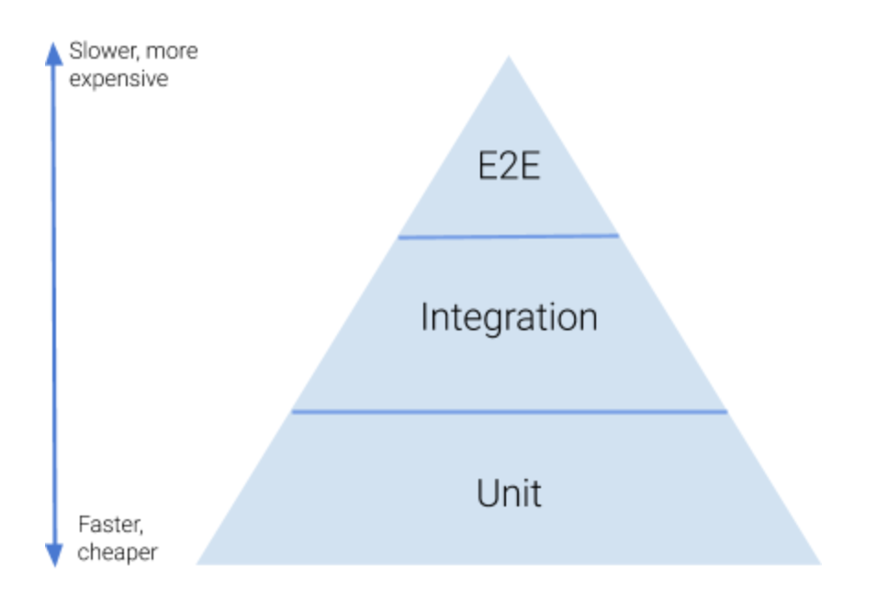
integration testing
tests that cover multiple layers of an application in combination.
integration tests launch the entire Spring context, including business and data components
automated integration tests usually don’t rely on external dependencies (for example, in-memory database are used or stubs for external services)

Slide 4
Spring boot tests
Spring Boot provides a @SpringBootTest annotation that can be used to quickly launch an integration test
integration tests may start from the controller layer or the service layer
to configure a web environment to be used in the test:
MOCK: To unit test controllers in a mock web environment. This is similar to doing unit tests.
RANDOM_PORT: Launch the entire web context, including other layers, in an embedded server on an available random port.
DEFINED_PORT: Similar to RANDOM_PORT, except that you hardcode a port number. May lead to port conflicts.
NONE: Loads up a Spring context without a web context.

Slide 5
Testing slices with spring
slice = a particular layer / domain of an application (controller, repository etc)
testing slices of application allows for focused, fast, light testing and facilitate targeting specific functionality
Spring Boot test slice annotations load an ApplicationContext and select components that make sense for the specified slice
@WebMvcTest
used with tests that focus just on the Spring MVC components
will disable all auto configuration that is unrelated to web MVCs (for example, @Service, @Repository)
MockMvc bean is used to make requests
@MockBean is used to mock service beans, if needed

Slide 6
best practices for testing
FIRST properties of a good test:
[F]ast
[I]solated
[R]epeatable: produces the same results each time you run it. You must isolate them from anything in the external environment not under your direct control.
[S]elf-validating
[T]imely

Slide 7
bibliography
Spring in Action, by Craig Walls
Java Unit Testing with Junit 5, by Shekhar Gulati, RahulSharma
Pragmatic Unit testing in Java 8 with Junit, by Jeff Langr

Slide 8

Q&A

Slide 9
THANK YOU
DANIELA CIUPERCA

